Slide 1
Project - Inventory Management
Team Name –> Group – 1
Member 1 –> Vikas Bevoor
Member 2 –> Sumit Yenugwar
Member 3 –> K.Shilpa
Member 4 –> Swapna
Member 5 –> V Anil Kumar
Member 6 –> Amit Sharma
Mentor Name -> Vinod and Rajashekar

Slide 2
Business Problem:
Poor inventory management leads to a loss in sales which in turn paints an inaccurate picture of lower demand for certain items, making future order predictions based on that past data inherently inaccurate. Instead, smart retailers use real-time data to move inventory where it’s needed before it’s too late. Additionally, they use predictive analytics to decide what to stock and where based on data about regional differences in preferences, weather, etc

Slide 3

Project Architecture / Project Flow
Business problem understanding
Understanding the data
Data Preparation
Feature engineering
Model Building and Evaluation
Deployment

Slide 4
Exploratory Data Analysis (EDA) and
Feature Engineering

Slide 5
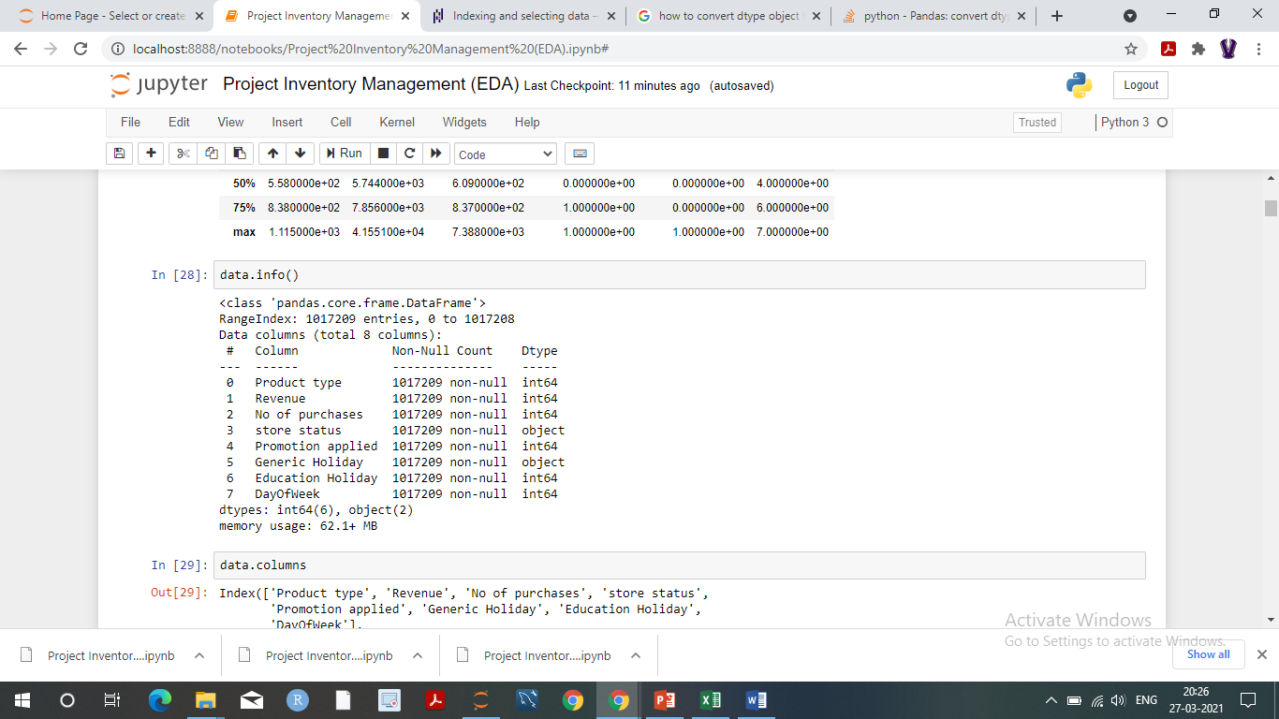
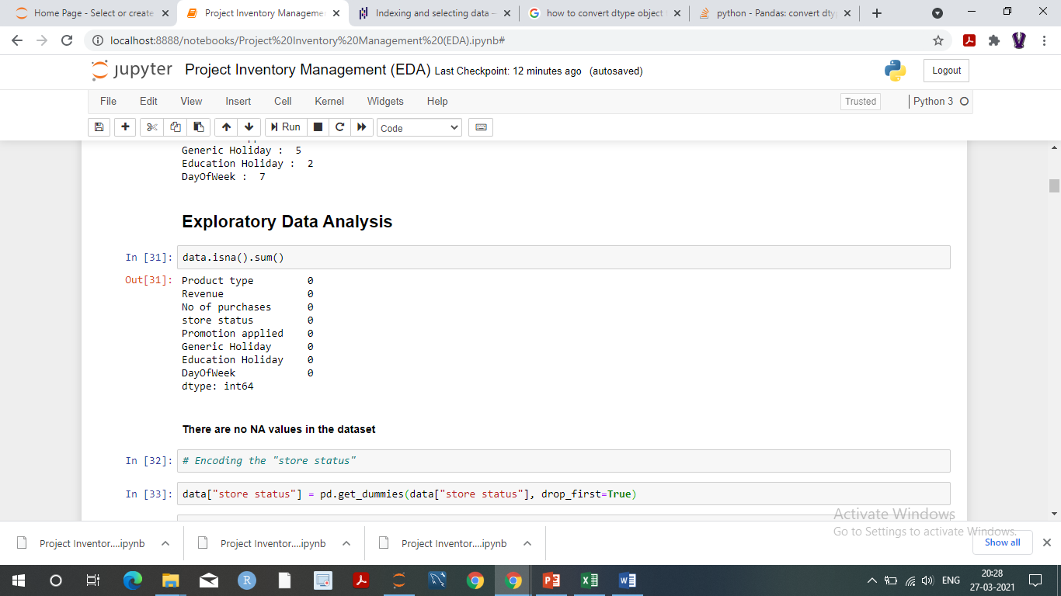
Data set details
Total Records - 1017209, 8
Rows - 1017209
Columns - 8
4) Data information
5) Null values

Slide 6
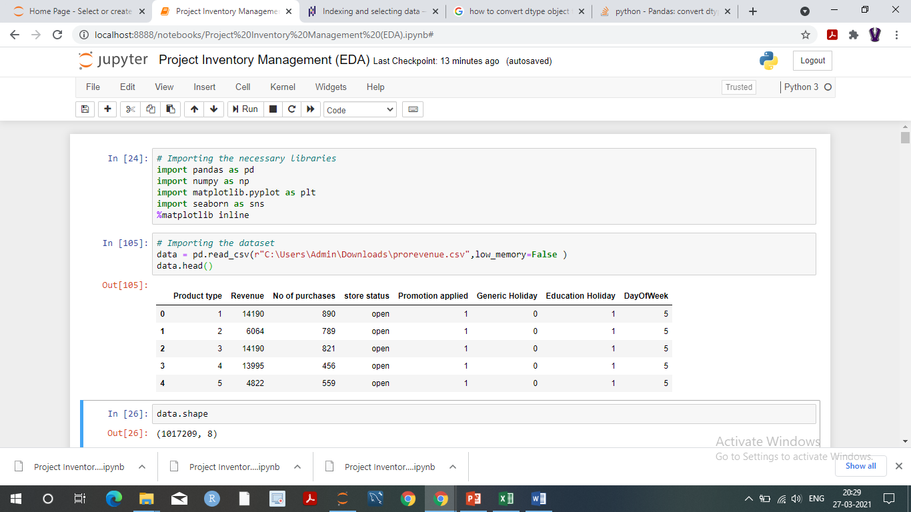
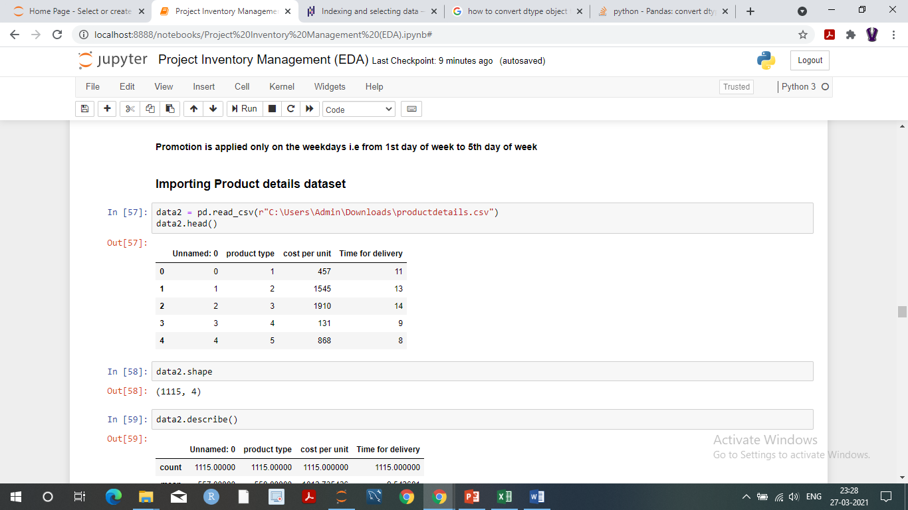
Product Revenue Data -
Product Details Data-

Slide 7
Exploratory Data Analysis (EDA)
Objectives of EDA –
Find Patterns
Spot odd-values / anomalies
Check assumptions
Steps to be performed –
Univariate analysis – histogram , boxplots
Bivariate analysis – bar plots
Multivariate analysis – cross Matrix analysis

Slide 8
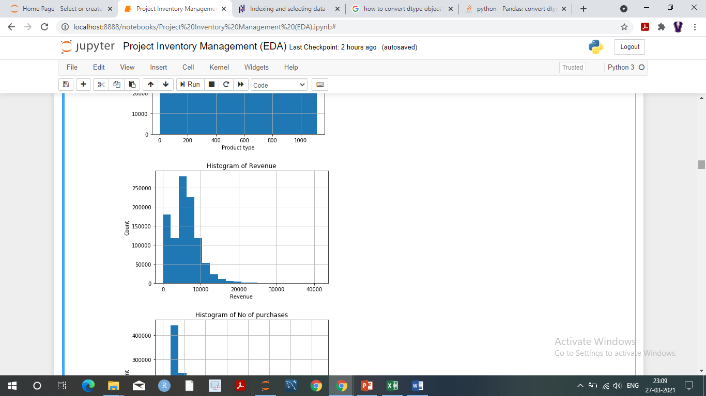
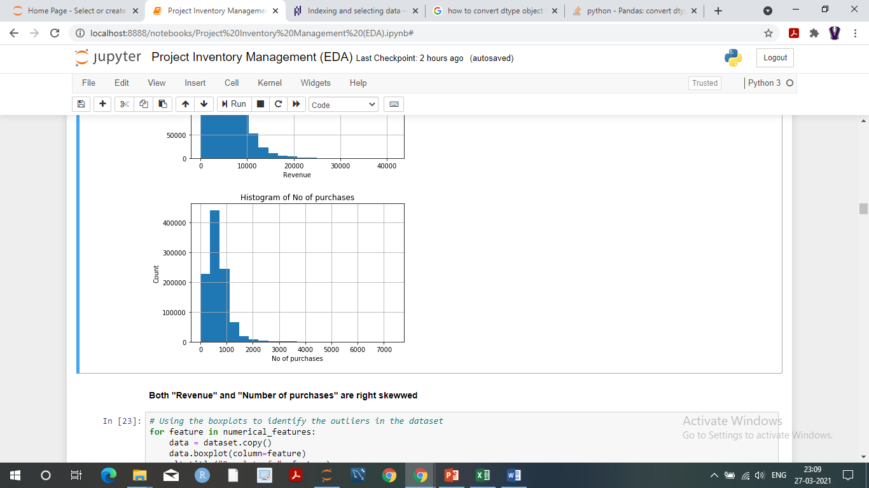
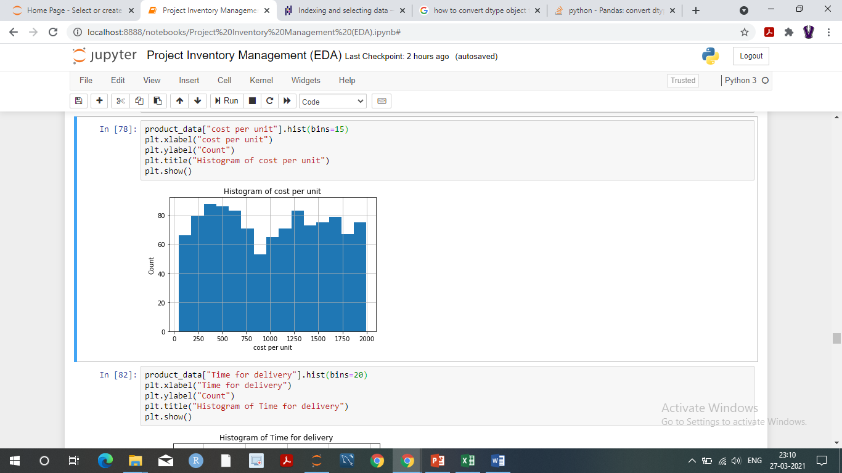
Histograms

Slide 9
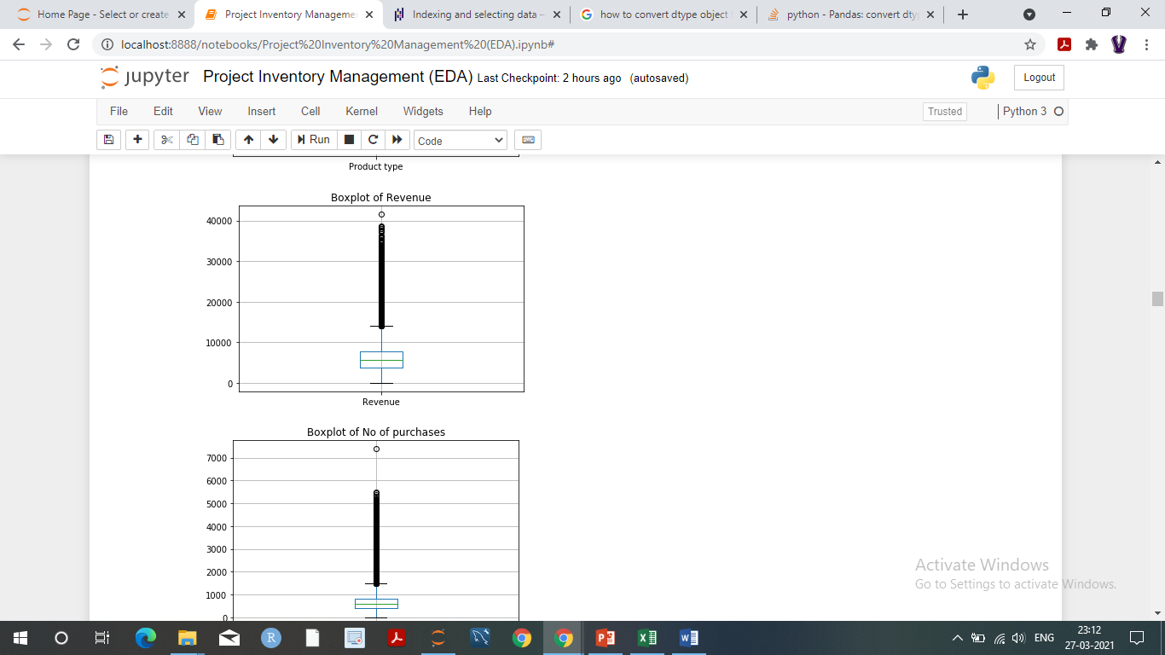
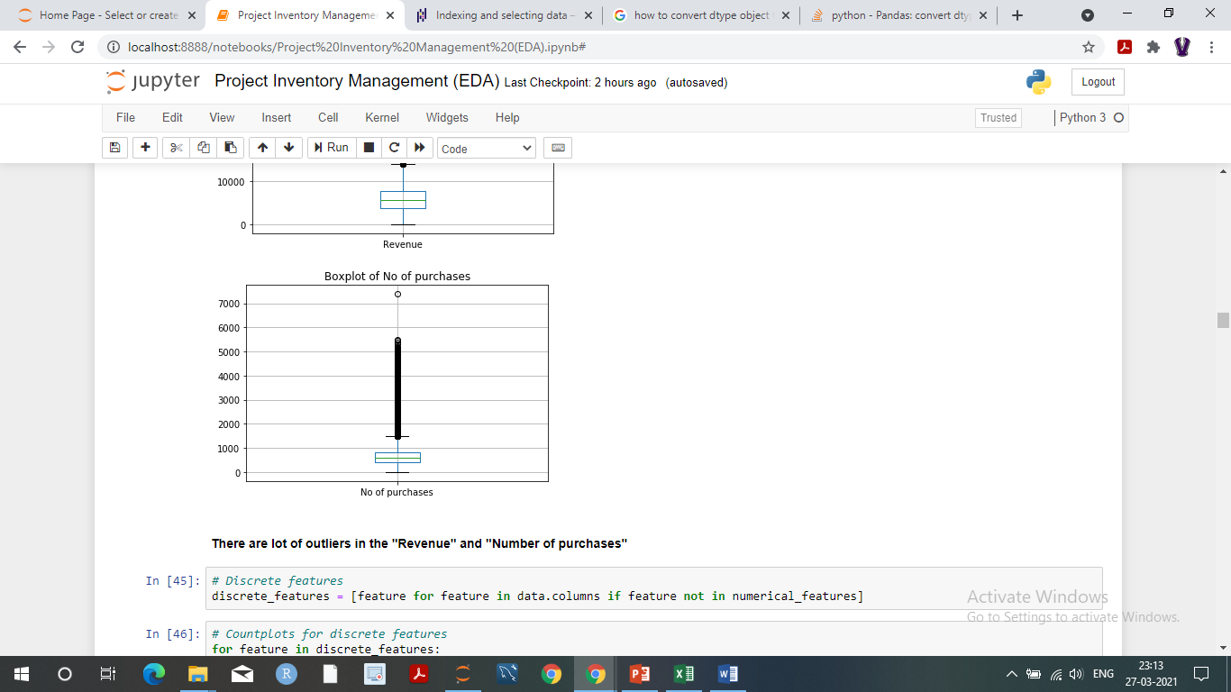
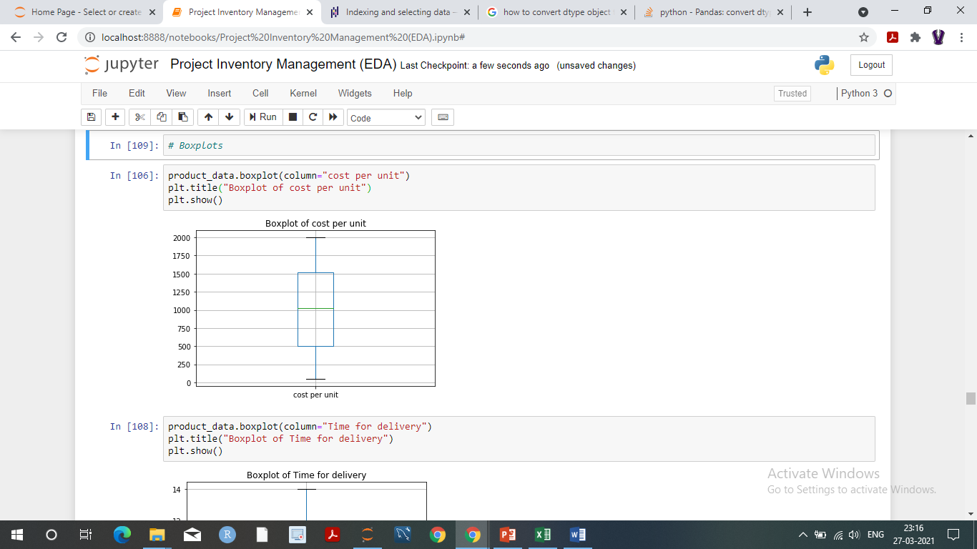
Boxplots

Slide 10
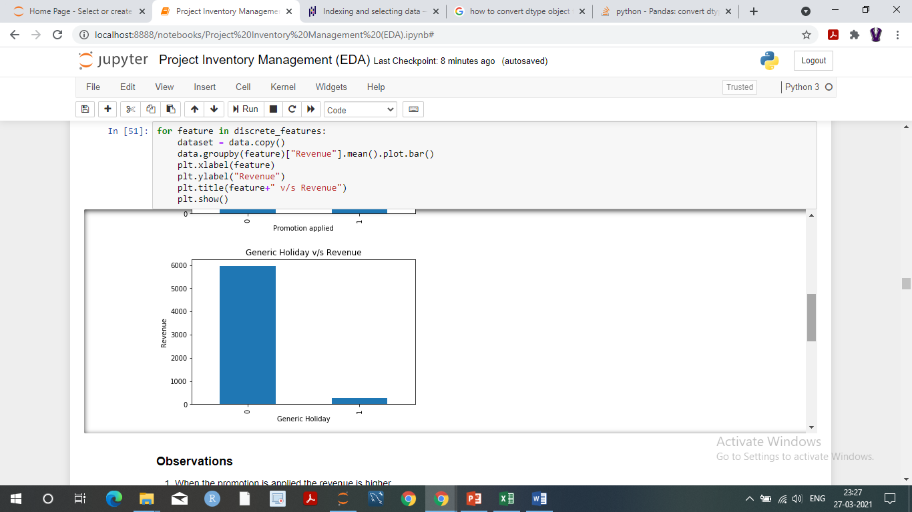
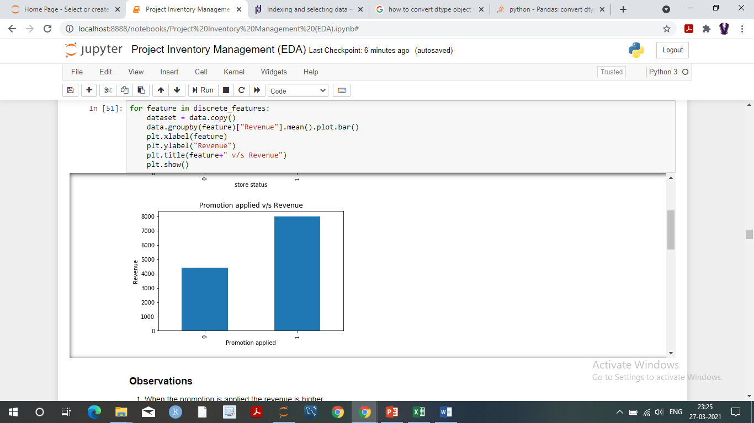
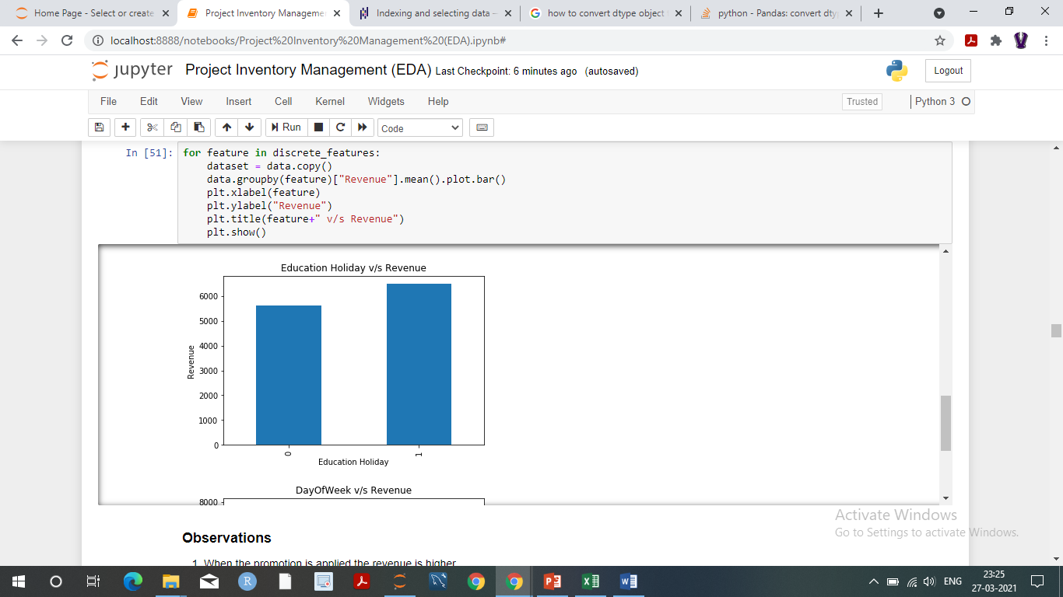
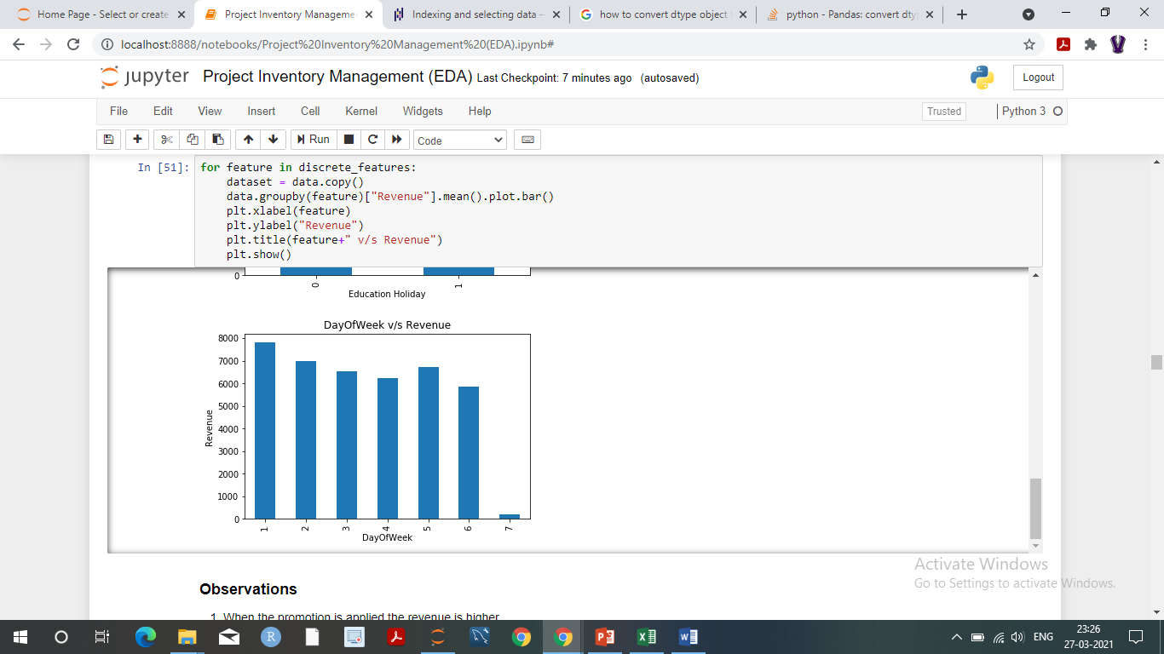
Bivariate plots

Slide 11
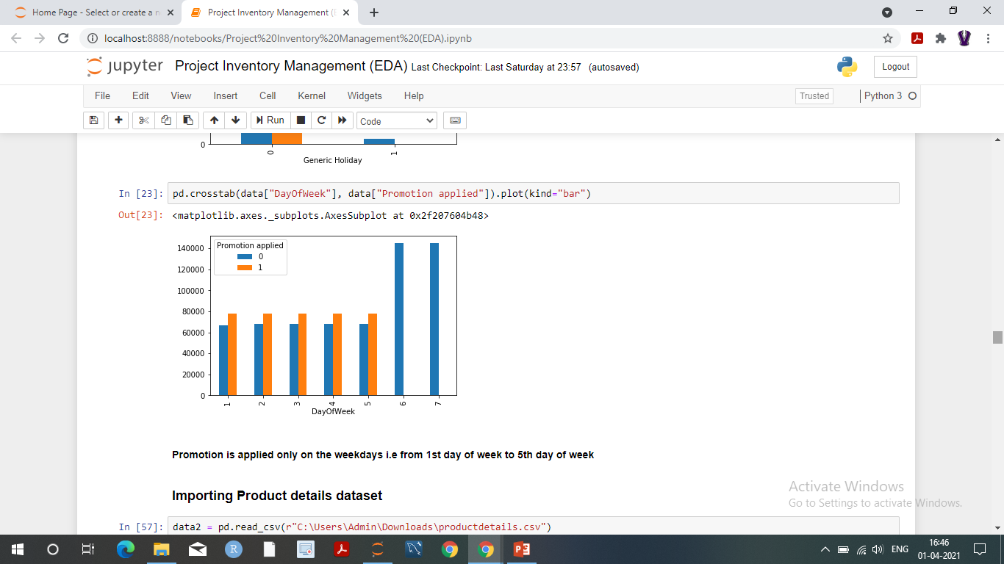
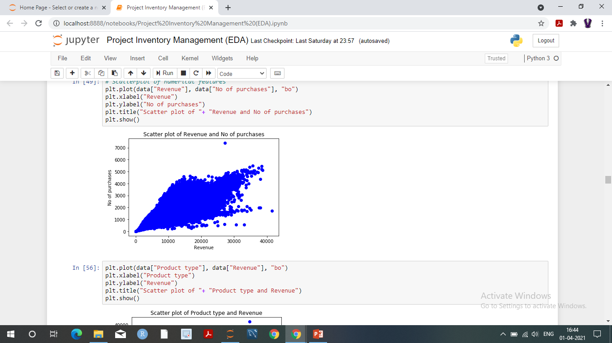
Bivariate plots

Slide 12
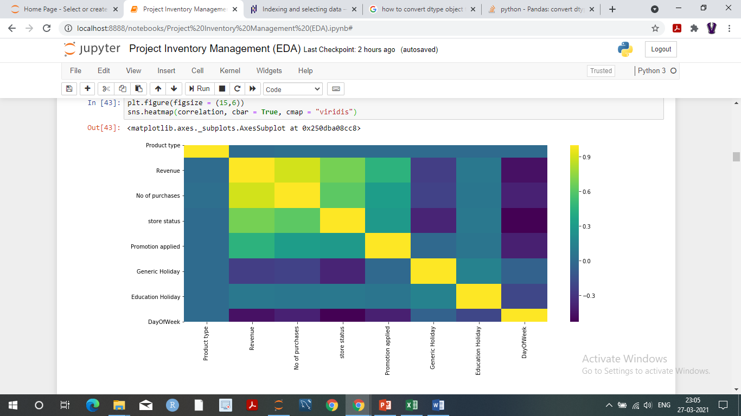
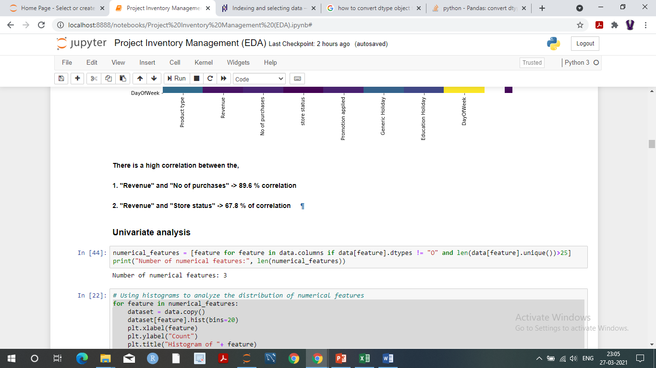
Correlation plot

Slide 13
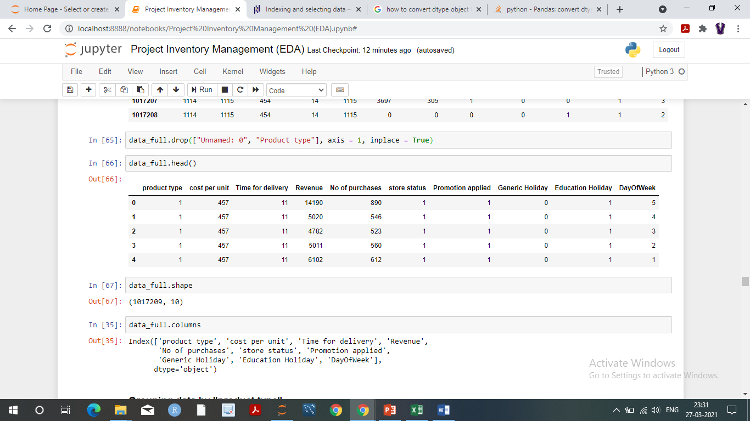
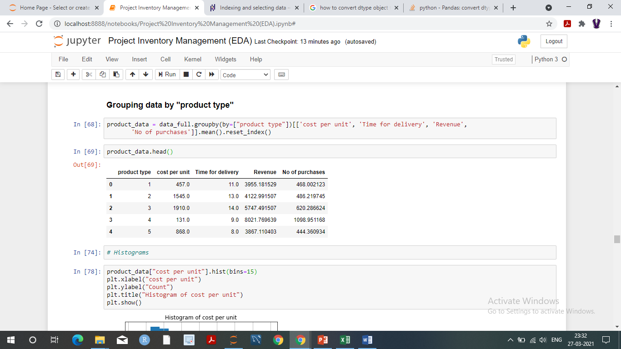
Data Combined
Data grouped by “product type”

Slide 14
Feature Engineering
Calculated Target Variable column no of units using The below Formaula
No of units = Revenue/Cost per unit
Normalized the Dataset using The RobustScaler Function
After Finding some insights from visualization and Knowing the correlation among the features and VIF Factor and Hypothesis P value we Have selected 4 Features [I,e Product type,Promotion applied,Generic Holiday and day ofweek ]

Slide 15
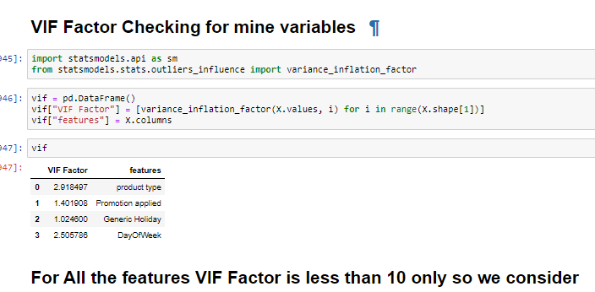
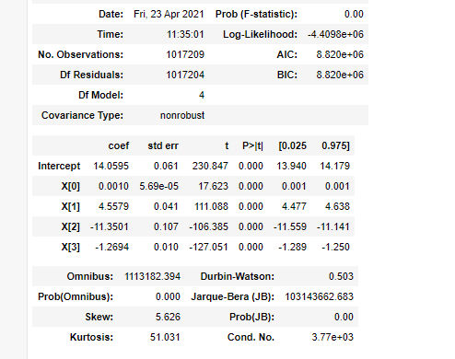
VIF Factor and Hypothesis P Values

Slide 16
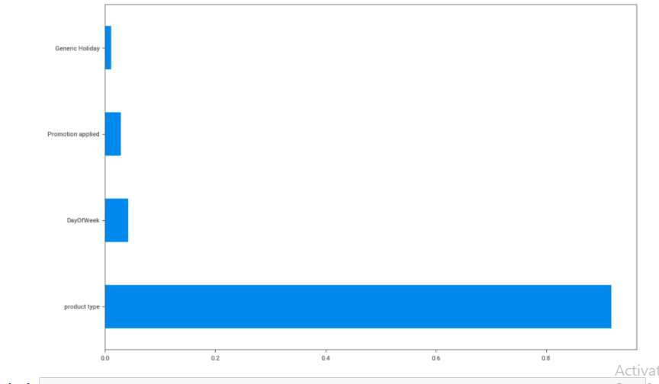
plot graph of feature importances for better visualization

Slide 17
Model : Random forest
Data set details: After EDA/Preprocessing data set has 1017209 observations and 4 independent variables.
Data Partition details: Using scikitlearn's train_test_split , Out of data taken 80% data for training and 20% for testing
Algorithms : Random forest regressor and Gradient boosting regressor :
For Random forest regressor : For Gradient boosting :
Minimum sample leaf: 1 max_depth=4
Minimum sample split: 2 RMSE=5.50
n_estimators=26 n_estimators=150
RMSE=6.17 Minimum sample leaf: 1
Minimum sample split: 2

Slide 18
Model – Evaluation:
For Random forest regressor :
Mean Absolute Error: 2.499656539198858
Mean Squared Error: 38.17446710266259
Root Mean Squared Error: 6.178548947986298
For Gradient boosting regressor :
Mean Absolute Error: 2.7146606036695338
Mean Squared Error:30.310143158932974
Root Mean Squared Error: 5.505464844945699
- As we all know lower the RMSE better the model is, so the Gradient boosting regressor has better RMSE than random forest regressor, hence we choose Gradient boosting regressor for our predictions.

Slide 19
Model Deployment using Flask
WE USED HEROKU PLATFORM AS A SERVICE FOR OUR DEPLOYMENT
Requirements prior to the deployment : .pkl file of model, app.py ,static folder in That css code and templates folder in that html code ,procfile, CONSIDERED MODEL.ipynb, requirements.txt.
requirements.txt consists of the libraries we used in python for this project and their versions
.pkl file of our model is generated after this command using pickle library
with open ('gbr.pickle','wb')
pickle.dump(gbr,f)
App.py consists of flask creation and names, features in our model for the prediction.
html and css codes mainly for web applocation .
HEROKU apps include a Procfile that specifies the command that are executed by the app on startup.

Slide 20
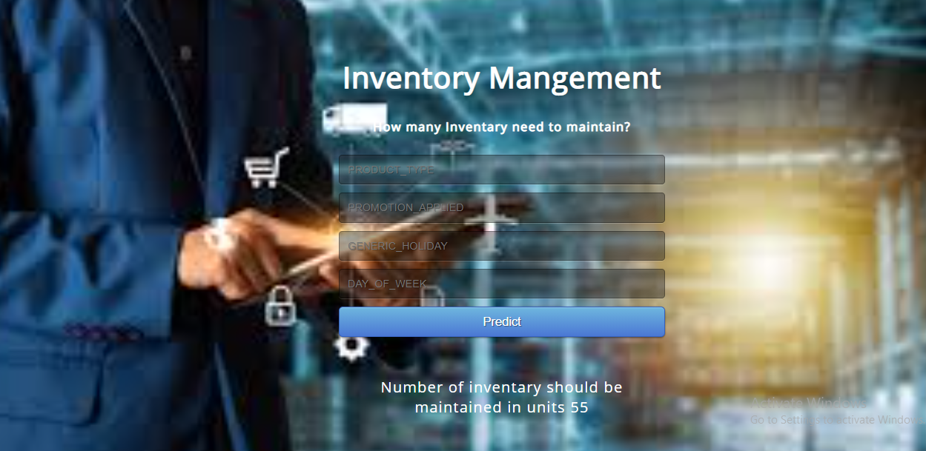
https://inventary-management-project.herokuapp.com/predict

Slide 21
THANK YOU

